Slide 1

Unsolved
Project by (un)solved

Slide 2
01.
Our Team
04.
Stages of Develpoment
02.
About Our Project
05.
What We Used
03.
Our Goal
06.
Demonstration

Slide 3
Our Team
Kalina Noncheva
Kamelia Ivanova
QA Engineer
Scrum Trainer
Maria Kostova
Niya Runcheva
Back-end Developer
Front-end Developer

Slide 4


About Our Project
UNS LVED

Slide 5
Our Goal

Slide 6
Stages of Development
Stage 3
Stage 2
Stage 1

Slide 7








What We Used

Slide 8
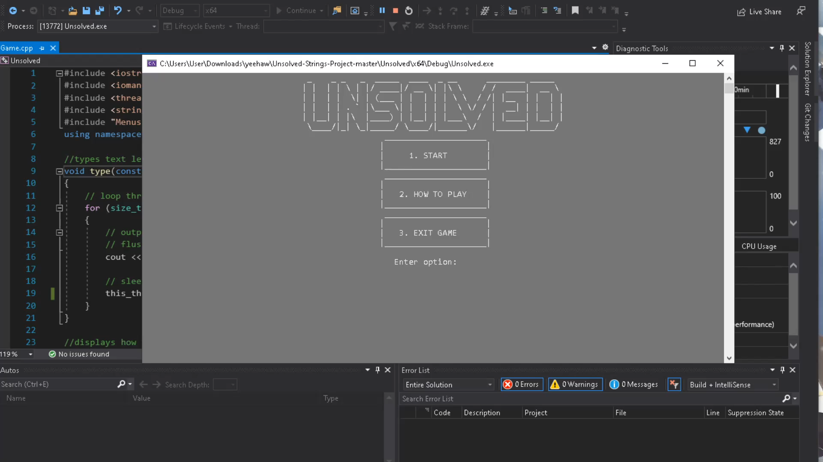
Demonstration

Slide 9
Thank you for your attention!
KPNoncheva19@codingburgas.bg
KIIvanova19@codingburgas.bg
MDKostova19@codingburgas.bg
NSRuncheva19@codingburgas.bg

